Slide 1


Student Lifestyle & Well-being Survey
Predictive Analytics Project Report (2025)
An intensive study exploring the intersection of academic pressure, daily routines, and mental health through data science. Submitted by Vansh Garg under the guidance of
Dr. Tanima Thakur at Lovely Professional University.

Slide 2

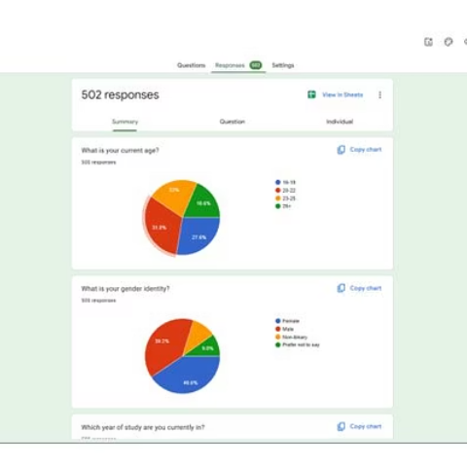
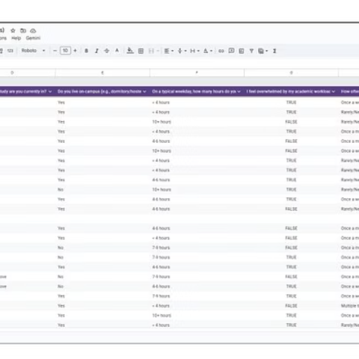
Project Overview & Abstract
This project presents a comprehensive predictive analytics study aimed at understanding student lifestyle patterns and stress management behavior using a self-collected survey dataset of 500 responses.
500 Student Responses
41 Distinct Survey Questions
Focus on Sleep, Academics, and Mental Health

Slide 3




The Data Science Workflow
A systematic analytical pipeline was followed to translate raw survey responses into actionable insights.
Preprocessing
Exploratory Analysis
Cleaning, normalization, and Likert-scale encoding (1-5).
Visualizing distributions and identifying key behavioral trends.
Modeling
Evaluation
Applying Regression, Classification, and K-Means Clustering.
Validating results using K-Fold Cross Validation and PCA.

Slide 4

Demographics & Academic Profile
The survey captured a diverse range of student backgrounds and living situations.
Age & Gender
Living Situation
Study Habits
Primary age group: 20-22 (150 students). Gender split: 180 Female, 180 Male.
280 students live on-campus, while 215 live off-campus.
135 students spend less than 4 hours on study, while 115 spend over 10 hours.

Slide 5



The Academic Pressure Cooker
Exploratory data analysis revealed significant levels of stress related to workload and performance.
52%
28%
56%
Overwhelmed
Dissatisfied
Future Anxiety
260 students feel overwhelmed by their academic workload.
140 students are dissatisfied with their current academic performance.
280 students feel the college is not adequately preparing them for careers.

Slide 6
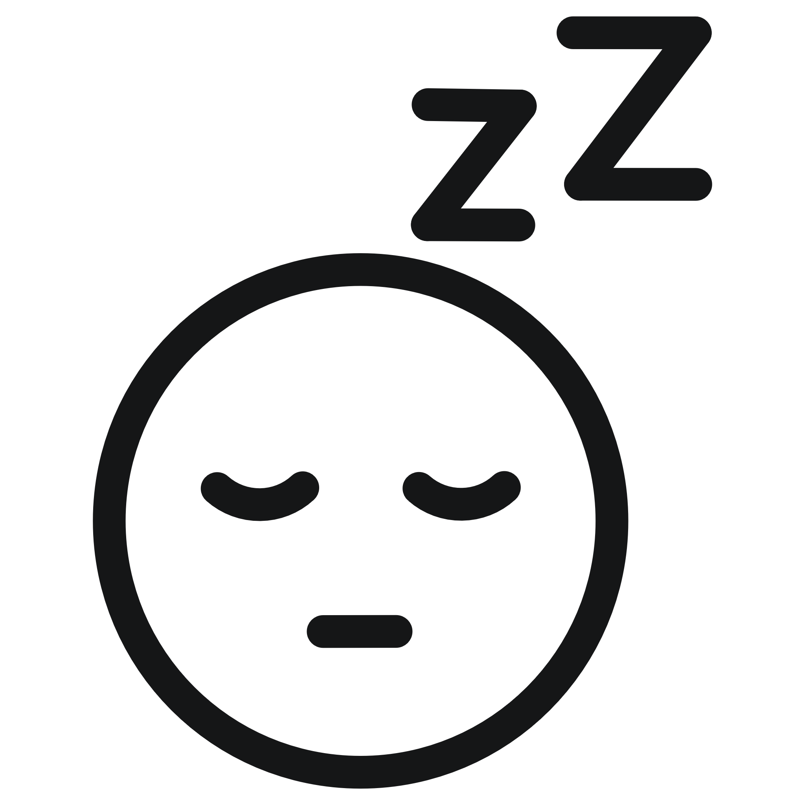


Lifestyle & Well-being Trends
Physical health and social support systems vary widely across the student population.
Sleep Deprivation
Physical Health
Social Support
Distribution is even across all categories, with many getting less than 5 hours.
160 students rate their physical health as "poor," with 160 exercising 0 days/week.
300 students have supportive family, yet 300 also report feeling lonely often.

Slide 7
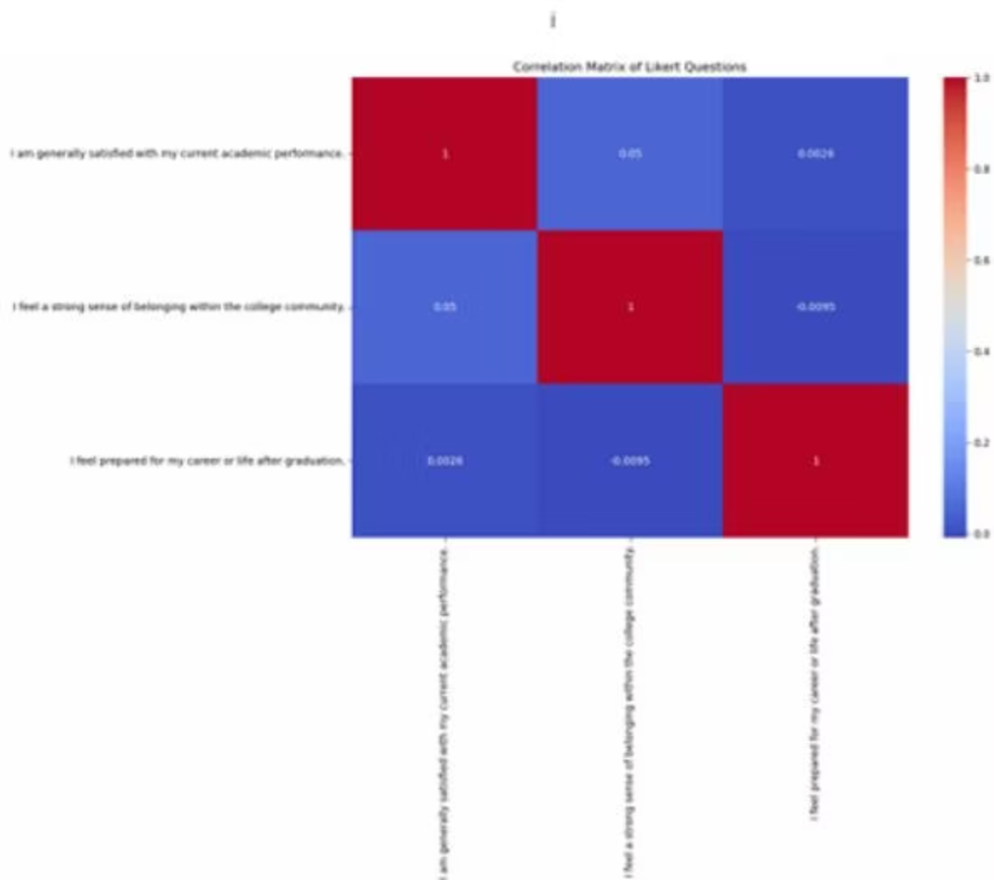
Correlation & Regression Insights
Statistical analysis quantified the relationship between lifestyle and stress management.
Key Correlations
Positive correlations were found between effective time management, adequate sleep, and stress handling.
Regression Metrics
MAE: 1.49
RMSE: 1.58
Mean R²: -0.033 (K-Fold)

Slide 8
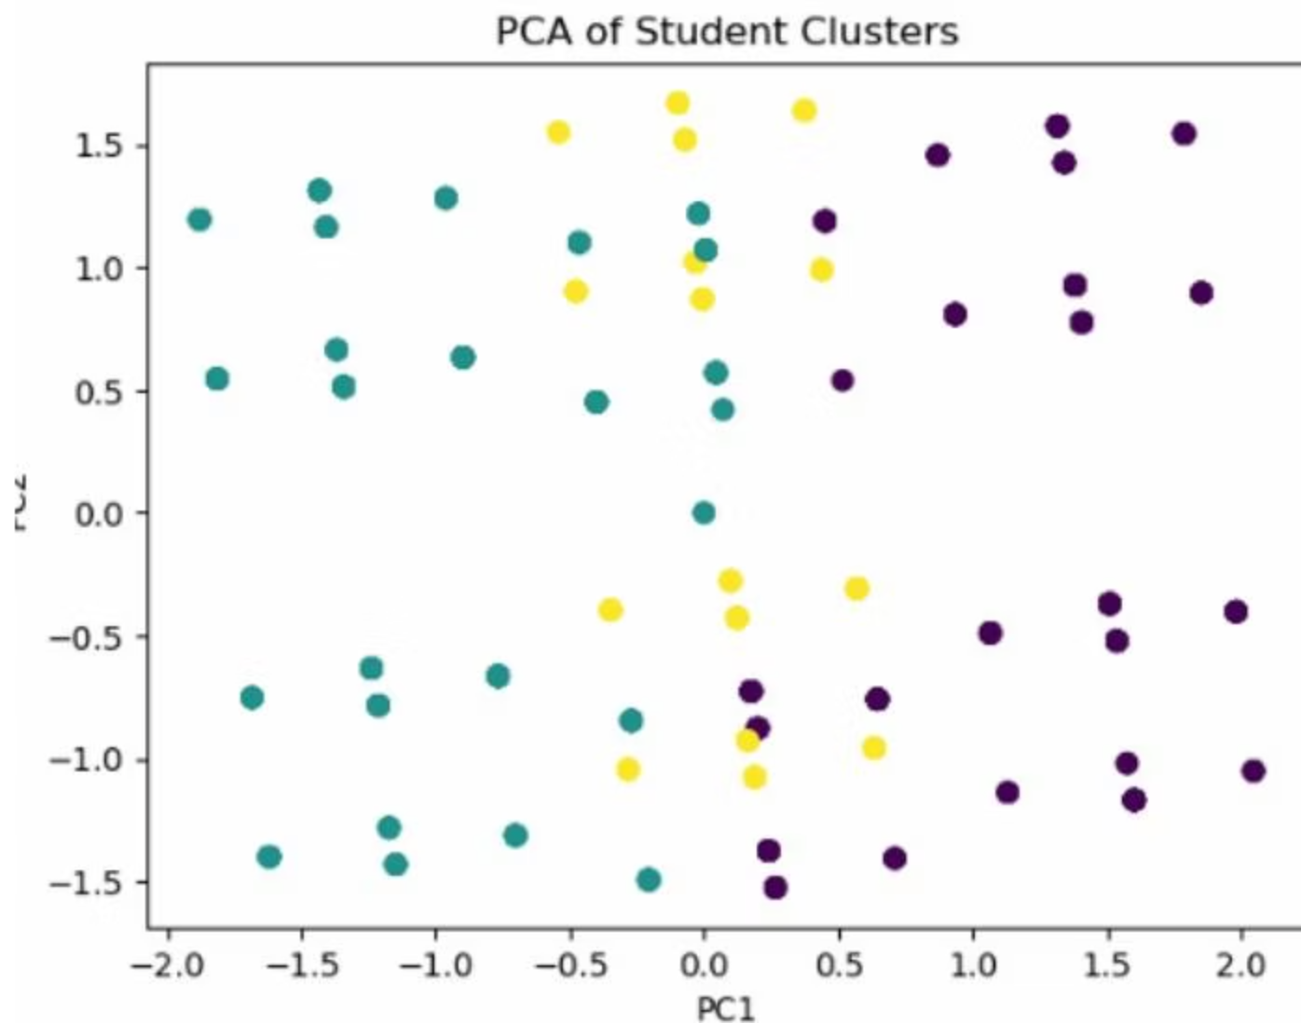
Clustering & Classification
Using unsupervised learning to group students by behavioral similarities.
PCA Visualization
Principal Component Analysis revealed three distinct clusters of students based on lifestyle and stress features.
Logistic Regression
Achieved an accuracy of 58.9% in classifying students into effective vs. ineffective stress management categories.

Slide 9

Conclusions & Key Findings
The study confirms that stress is a multidimensional phenomenon dependent on combined lifestyle factors.
Primary Drivers
Negative Impacts
Sleep patterns and time management are the most significant contributors to stress handling.
Academic workload and perceived pressure significantly reduce stress-handling capacity.
Institutional Role
Data-driven insights can help universities design better well-being initiatives and support systems.

Slide 10




Future Scope & Resources
Expanding the horizon of student well-being through advanced technology.
Advanced Models
Real-time Monitoring
Longitudinal Study
Implementing Neural Networks and Random Forests for higher accuracy.
Integrating wearable device data for immediate stress detection.
Tracking changes over multiple semesters to identify long-term trends.
Access the full project: GitHub Repository | Survey Form

